Slide 1











Consumer Financial
Protection Agenda
Fall 2023 – Spring 2024
Notes:
Horacio

Slide 2
Presenters
Brent Adams | Woodstock Institute
badams@woodstockinst.org
Meegan Dugan Adell | New America Chicago
adell@newamerica.org
Ricki Lowitz | Working Credit
ricki@workingcredit.org
William McNary | Citizen Action/Illinois
mcnary@citizenaction-il.org
Horacio Mendez | Woodstock Institute
hmendez@woodstockinst.org
Abe Scarr | Illinois PIRG
abe@illinoispirg.org
Dan Schneider | Legal Action Chicago
dschneider@legalactionchicago.org
Notes:
Horacio

Slide 3
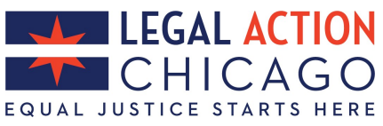
Protecting
Families in Debt
SB 2220 & HB 3452
Dan Schneider, Senior Attorney
Legal Action Chicago
dschneider@legalactionchicago.org

Slide 4

The Reality of Debt
>3M people in Illinois with debt in collections, and average household carries almost $90k – and growing
Residents of majority-POC neighborhoods in Cook County 2x as likely to face debt collection lawsuit
Many low- and middle-income families left to choose between paying debt and basic needs

Slide 5

Protecting Family Futures
SB 2220 (Martwick) / HB 2377 (Gong-Gershowitz)
  Increases “exemptions” for home, vehicle, tools
  Limits garnishment to 10% of weekly wages (down from 15%)
  Critical new protections for bank accounts

Slide 6
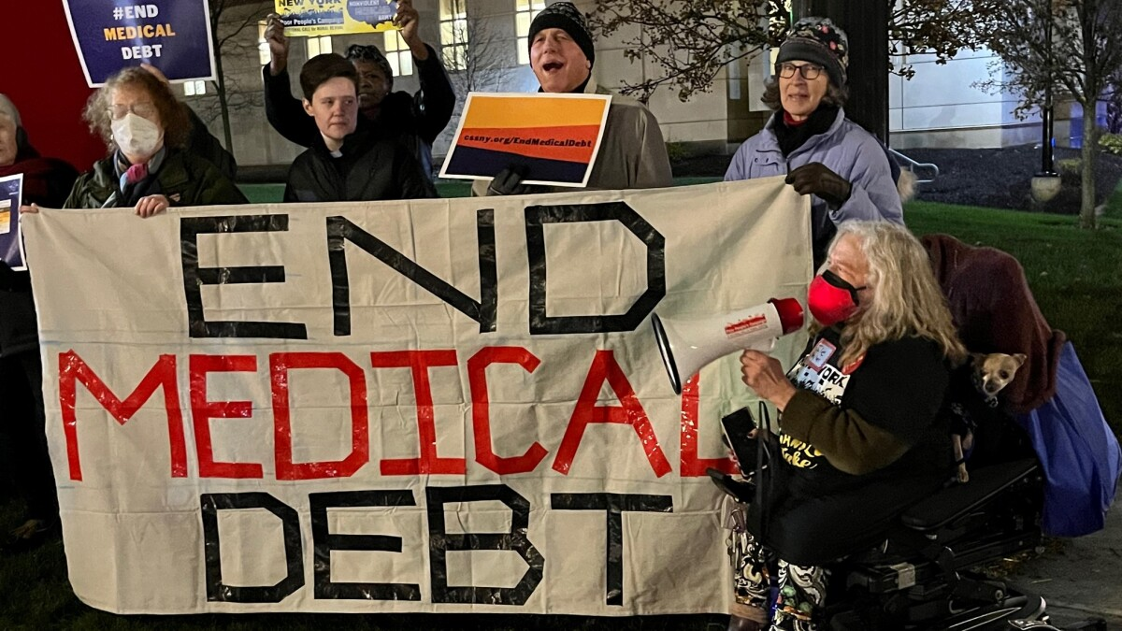
Containing Medical Debt
HB 3452 (Avelar) would prohibit reporting medical debt to credit bureaus via Consumer Fraud Act
Consumer Financial Protection Bureau rulemaking to remove medical debt from credit reports, stop use in underwriting

Slide 7
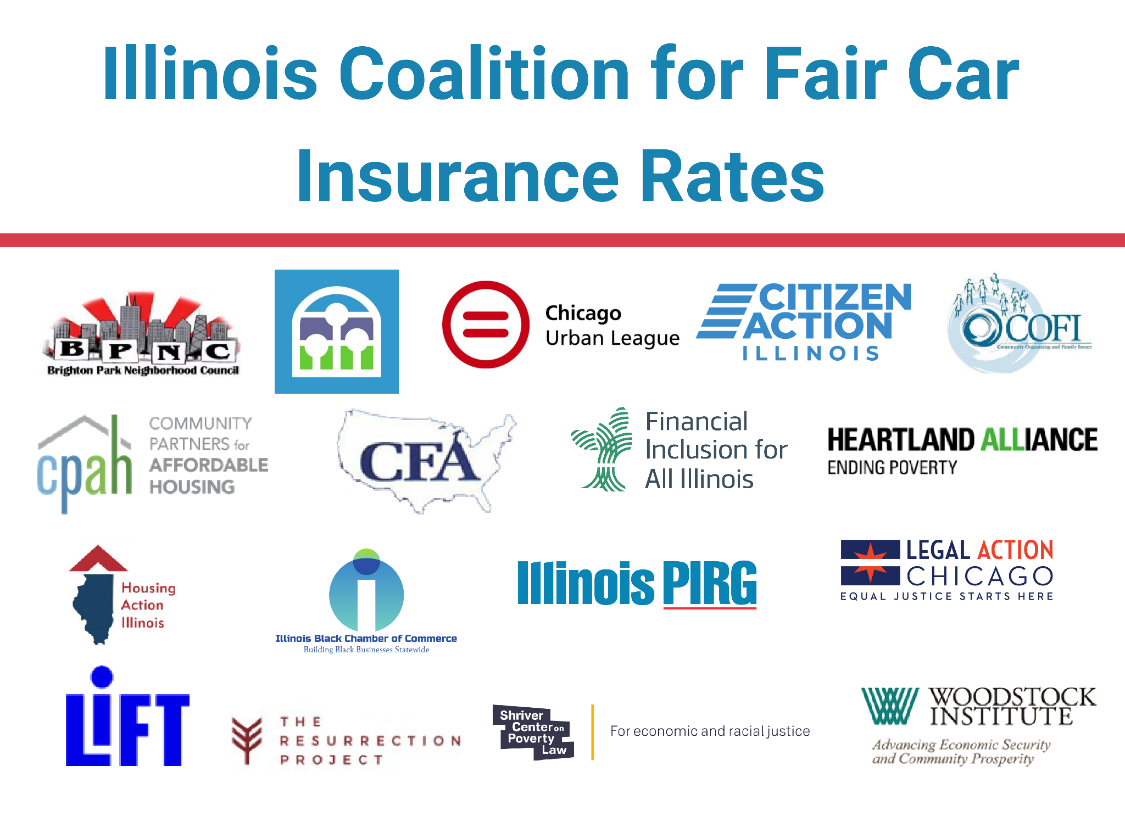

Slide 8
HB2203 - Guzzardi / Cervantes - Car Insurance Reform
1. Rate review
2. Prohibits unfair and discriminatory practices
End use of non-driving factors to set rates
Back end disparate impact test

Slide 9
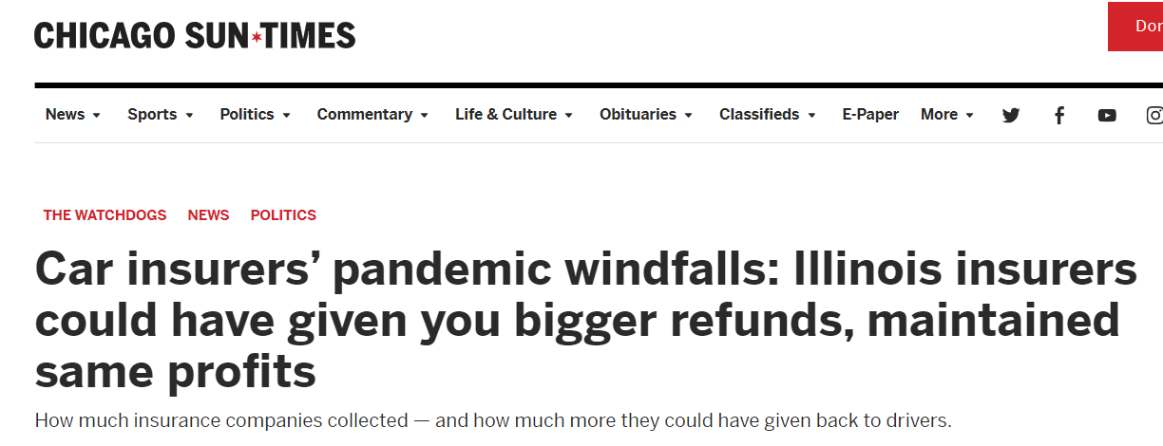

Slide 10
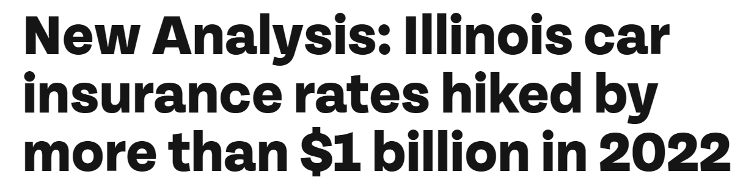

Slide 11
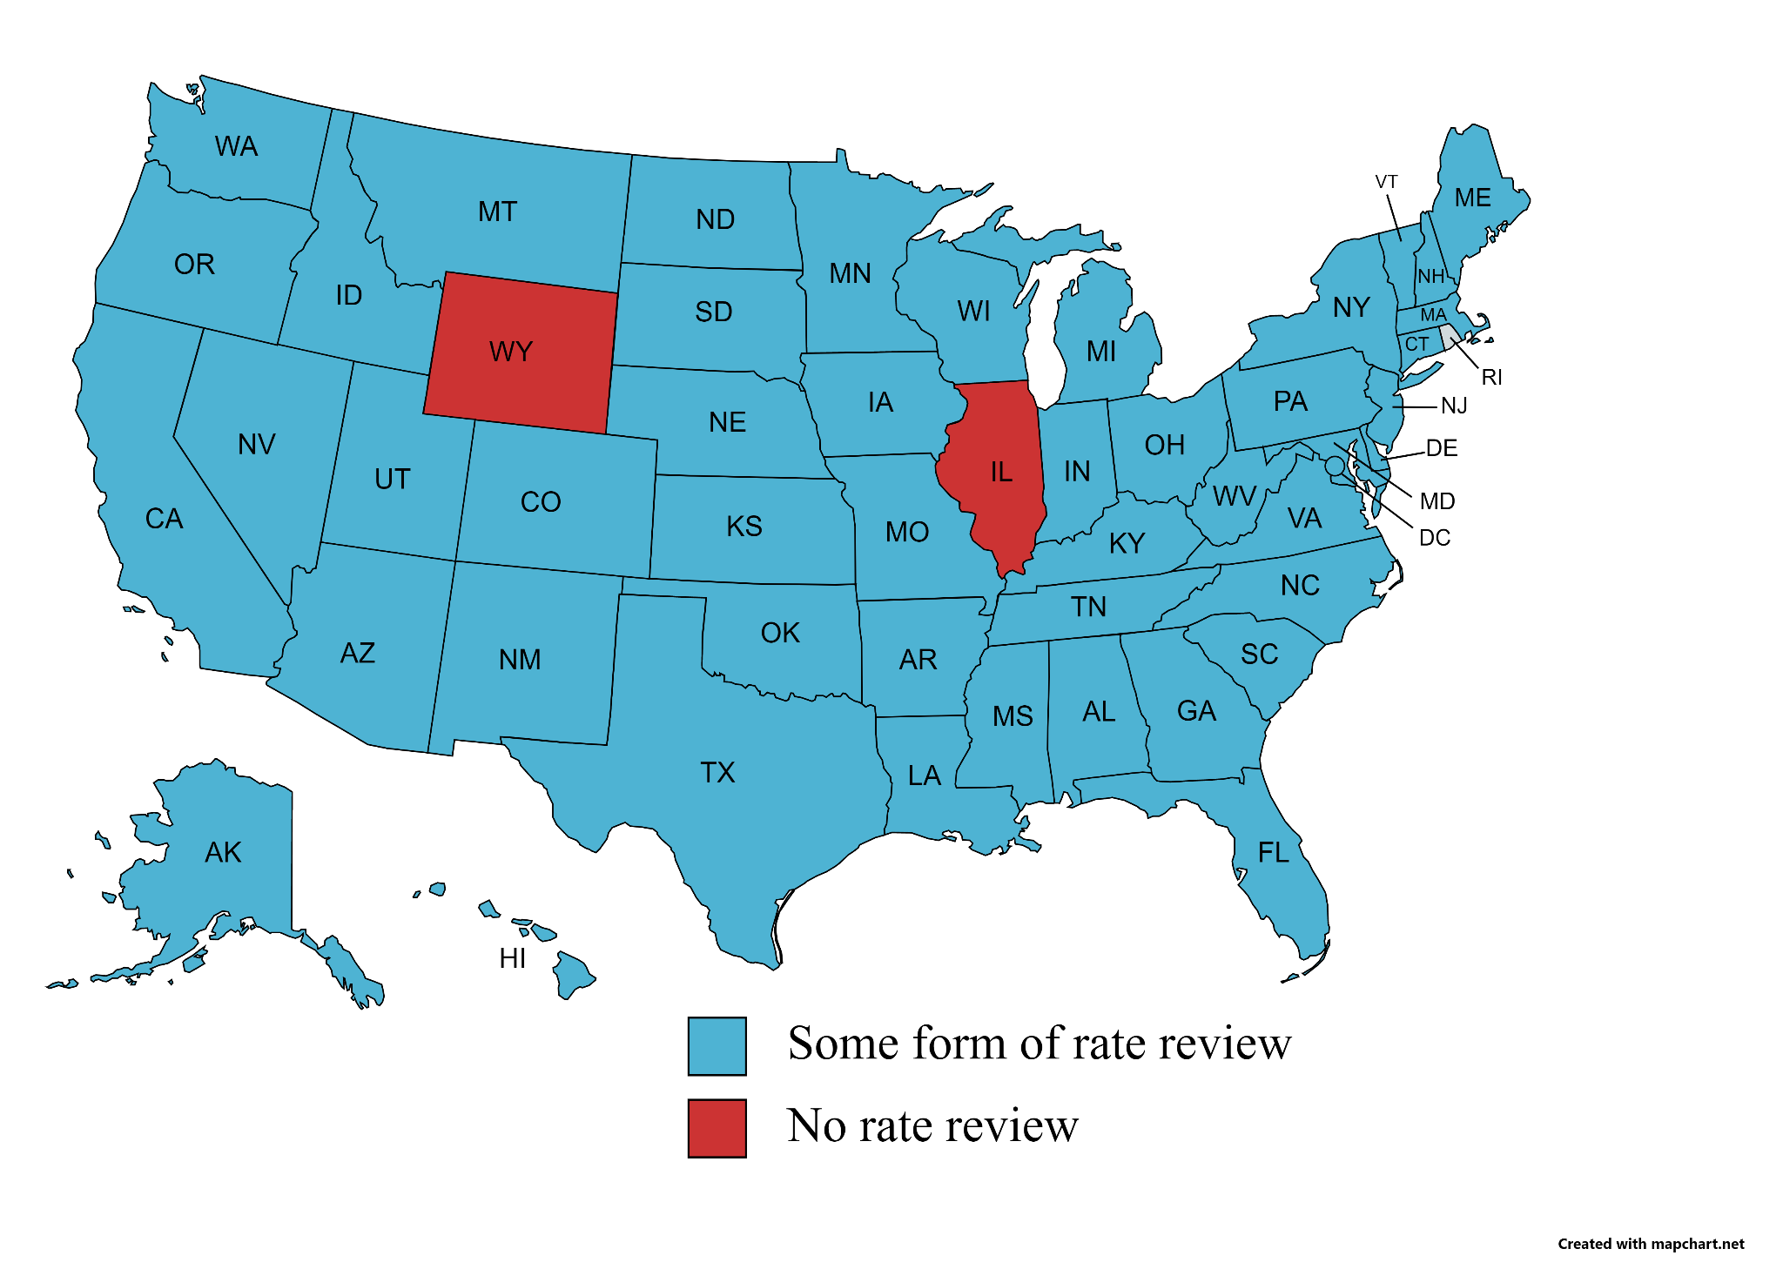

Slide 12
In December 2022, the Allstate CEO, in reference to company plans to continue raising rates, said:
“We may end up overshooting a bit, don’t know.”

Slide 13
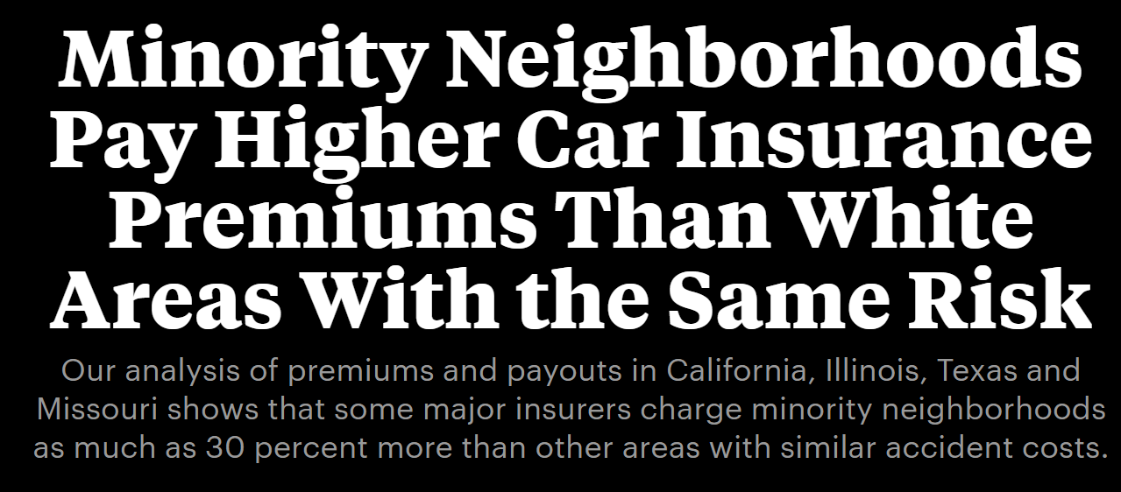

Slide 14
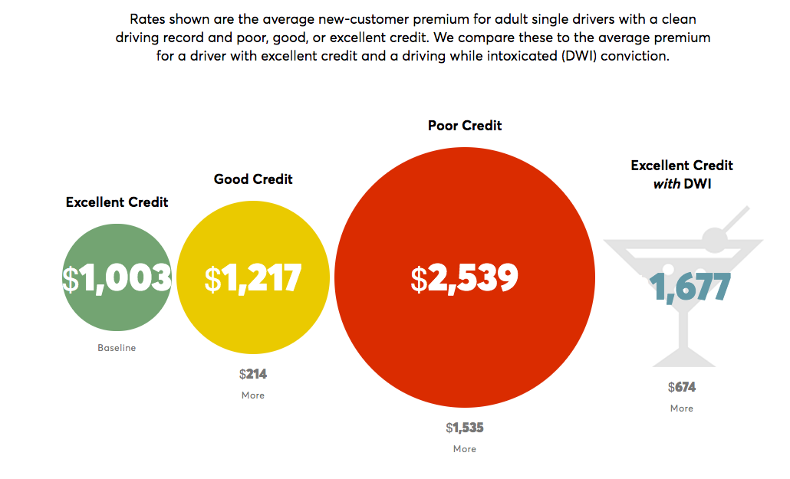
$

Slide 15

Utility Rate Hikes - Coming Jan. 1
Peoples Gas - $350M
Nicor - $250M
Ameren Gas - $50M
ComEd - $1.5B (over 4 years)
Ameren Electric - $481M (over 4 years)
To expect: likely positioning / negotiations on “future of gas”

Slide 16
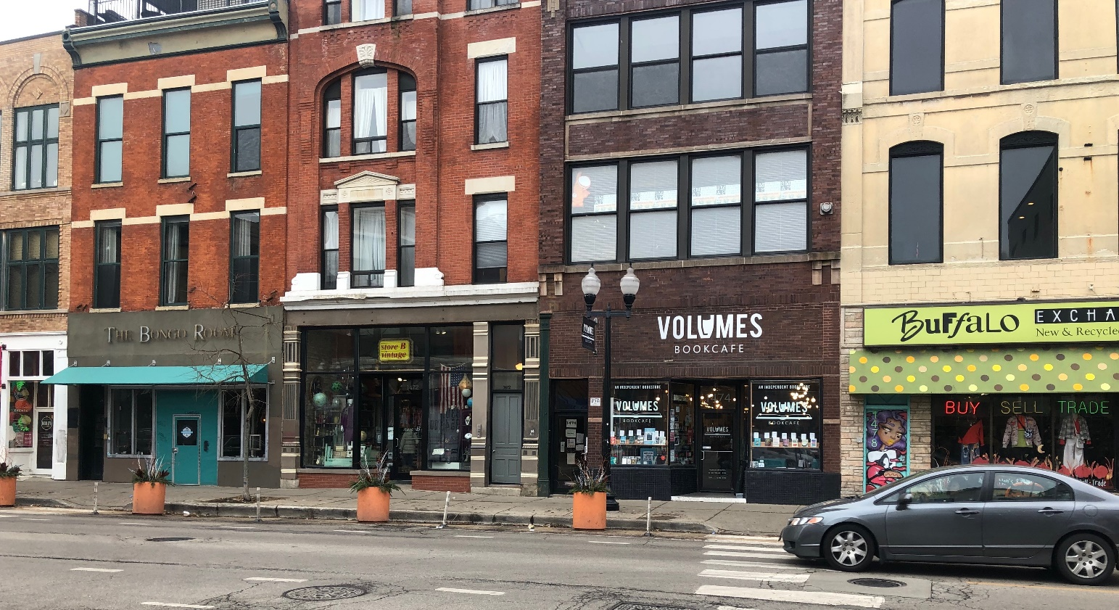
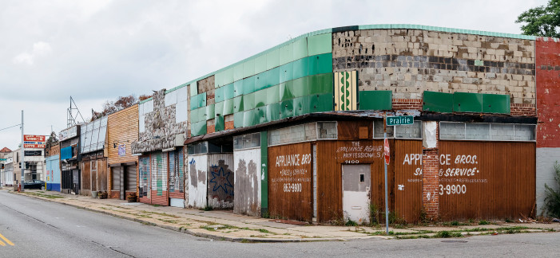
Protecting Small Businesses
Wicker Park, Chicago, IL
Where small businesses go, prosperity follows.
Detroit, MI
Photo by Marvin Shaouni, featured in Fortune magazine’s “How JPMorgan Chase Is Fueling Detroit’s Revival”

Slide 17
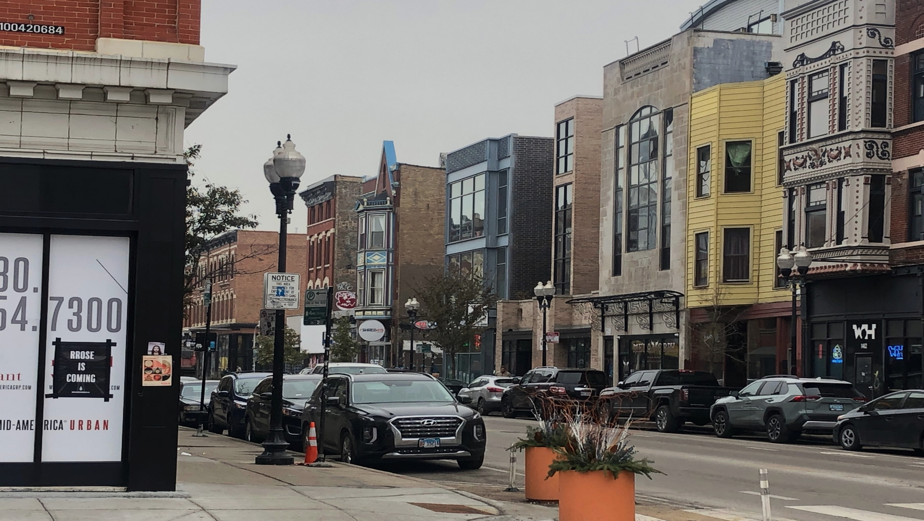
Do small businesses in communities of color receive their proportionate share of loans from banks?
Answer: NO!

Slide 18

PATTERNS OF DISPARITY: Small Business Lending in Illinois (Aug. 2019)
CRA Data – Only large banks
2015-2017
Loans under $100,000
Loans to small firms (under $1 Million in revenue)
https://woodstockinst.org/research/reports/patterns-of-disparity-small-business-lending-illinois/
Marcus Pickett, Founder & President of Temperature Doctors Heating & Cooling, Inc. - Rockford, IL

Slide 19
CHICAGO DISPARITIES:
RACE & ETHNICITY
Percent of Businesses/Percent of Loans for Loans under $100,000 by Census Tract Proportion of Non-White Residents, 2015-2017, Chicago Region
Sources: FFIEC CRA data, 2015-2017; HUD/USPS Vacancy Data, Q1-4, 2015-2017; 2015 Five-Year American Community Survey; Author’s calculations.
If Communities of Color received their proportionate share: 28,010 more loans, $354.9 M
Notes:
State
Illinois - 36.4% of business addresses were located in census tracts with non-white populations >40%, but rec’d only 33.3 % of number and 30.7% of dollar amount of CRA-reported loans <$100 K.
Proportionate share: 19,020 more loans, $460.3 M.

Slide 20
CHICAGO DISPARITIES: INCOME
Percent of Businesses/Percent of Loans for Loans under $100,000 by Census Tract Income Level, 2015-2017, Chicago Region
Sources: FFIEC CRA data, 2015-2017; HUD/USPS Vacancy Data, Q1-4, 2015-2017; Author’s calculations.
If LMI Communities received their proportionate share: 20,159 more loans, $372.6M

Slide 21
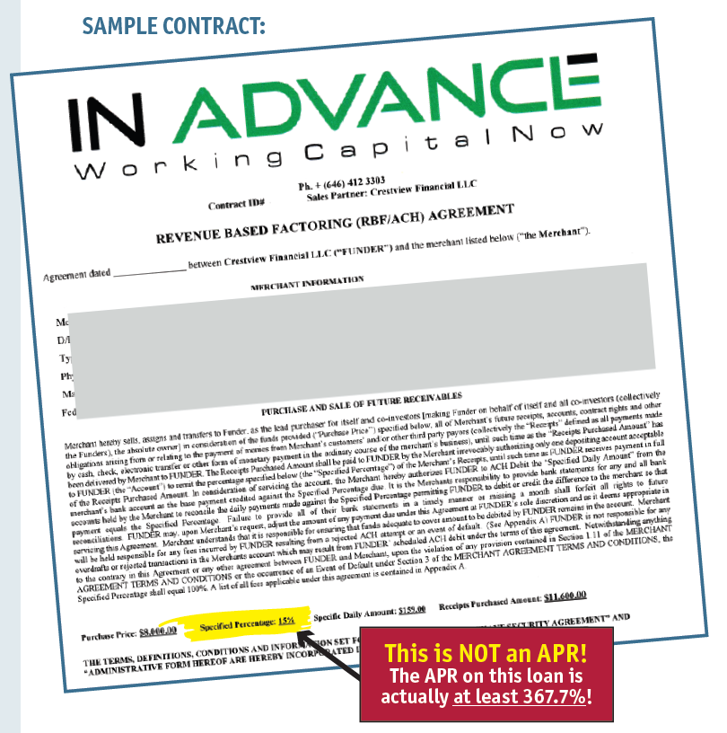

Slide 22
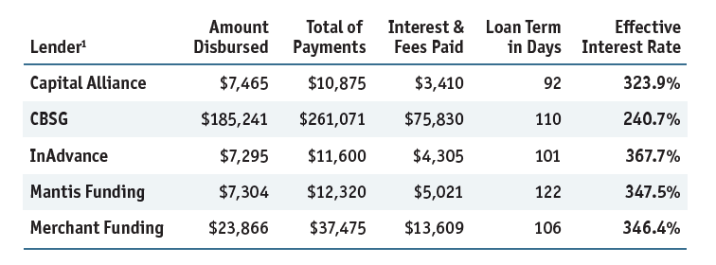
Sample Business Loan Terms
Predatory lenders target communities of color, lower income communities, and other vulnerable populations.
Entrepreneurship is path to economic security for people shut out of traditional employment. Formerly incarcerated people are 45% more likely to be entrepreneurs.

Slide 23
Responsible Business Lenders Coalition
Signatories agree to Small Business Borrowers’ Bill of Rights (BBOR)
BBOR includes APR disclosure, “ability-to-repay” requirement
Signatories include Allies for Community Business, Lending Club, and Funding Circle
borrowersbillofrights.org

Slide 24
SB 2234 / HB 3064 (Belt/Huynh) – Small Business Loan Transparency
Requires non-bank lenders to register with IDFPR
APR disclosures for small businesses
Follows California and New York
Exciting Update: Agreement in Principle!
Town Hall Meetings: Rep. Huynh -- 12/7, 6:30-8 in Chicago; Sen. Belt – 12/18, 6:30-8 in East St. Louis

Slide 25
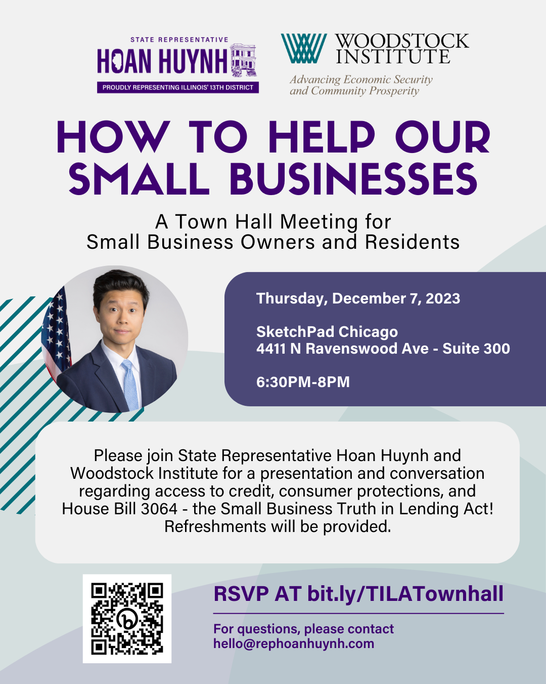

Slide 26
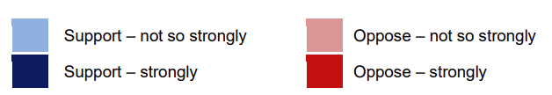
PLPA is Popular

Slide 27
PLPA is Working: Fees
Consumers saved more than $600 million.

Slide 28
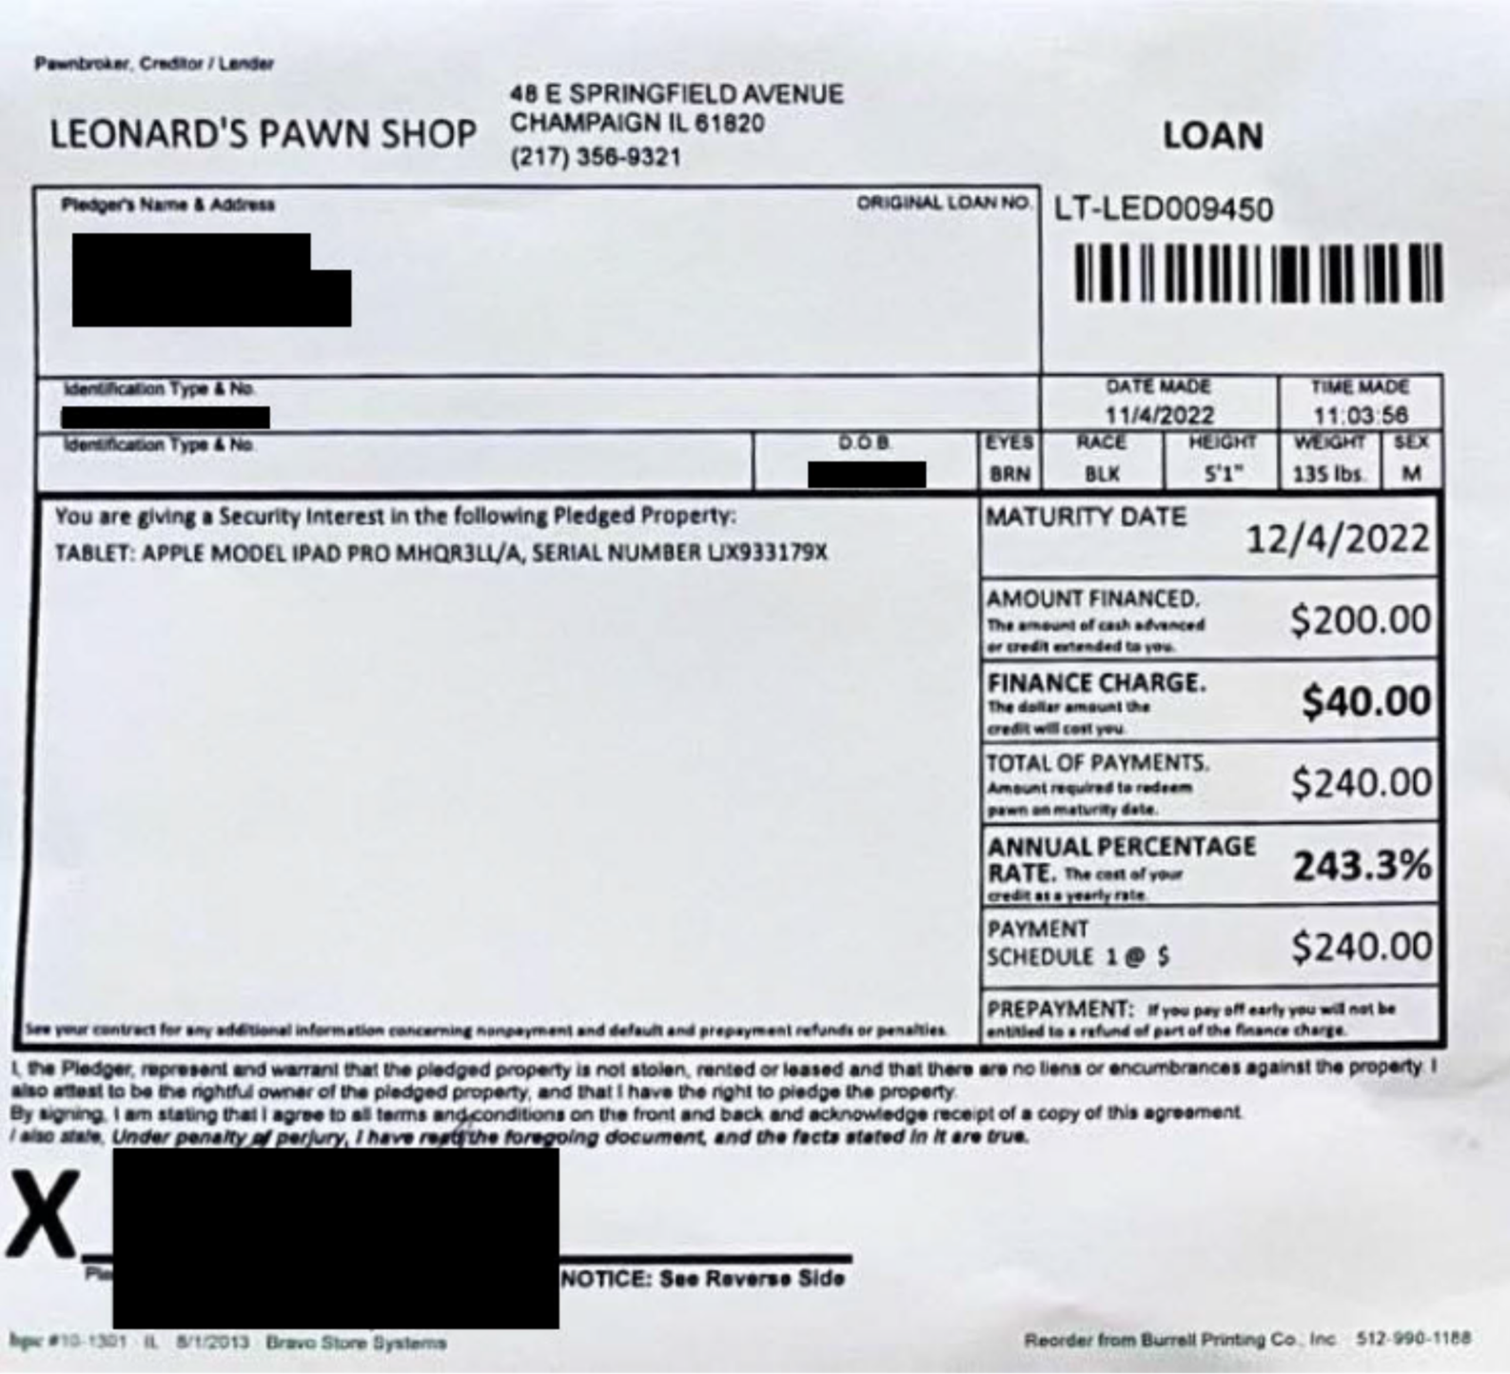
The Pawnbroker Loophole

Slide 29
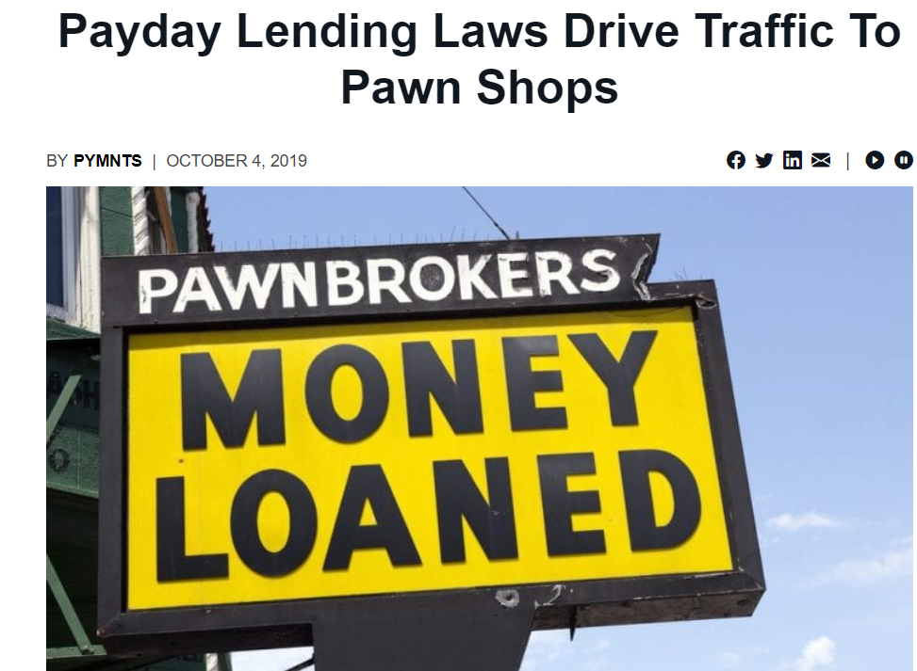
Source: https://www.pymnts.com/news/alternative-financial-services/2019/what-is-powering-the-emerging-pawnaissance/

Slide 30
Status
Negotiations ongoing.
Legislation next week is possible. Stay tuned.

Slide 31

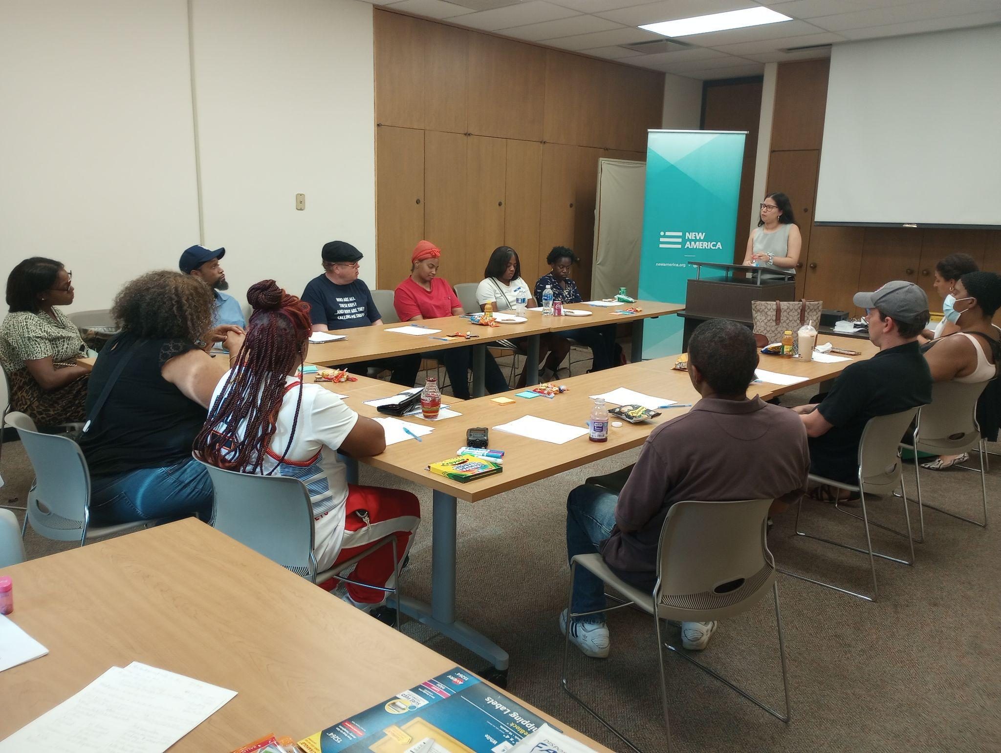
Work to Meet Consumers’ Needs for Short-term Cash Continues
“Immigrants are still going through the same situations…You almost always do not qualify [for a loan] and they give you a high interest rate. When there are no requirements, they ask you to have a good record or background. Even then, when they see how much you earn, they tell you no and they keep taking more and more money that you don't have.” (translated from Spanish) – Isabel, Logan Square
“...Even nowadays, some people still don't trust banks. Banks are not very friendly towards people with ITINs. It took me years to build credit, for example.” – Monica, Logan Square
“I think when it comes to income, they don’t have a lot of options for self-employment. They want a W-2. Some people make a lot of money doing hair, etc. and have the receipts to prove it, but if they don’t have a W-2 then they don’t give them a loan.” – Linsey, Chatham
“Honestly, I think outside of loans a lot of people I know, everyone from physicians to teenagers and everything in between, myself included, is using the gig economy...The gig economy is sort of everyone’s go-to as opposed to payday loans, as opposed to any loans. You know you’re earning your own money.” – Tamya, South Shore

Slide 32
Credit Repair Reform:
HB3461 (Meyers-Martin) & SB2135 (Feigenholtz)
Credit Repair Organizations (CROs) promise to “fix” your credit by getting “negative items” off your report
Charge approximately $100-$150 per month for disputing services; contracts have no end dates
Among the people we serve, 12% have used credit repair; most have spent $1,500 - $3,000 over 2-3 years; many have tried several times; average score when we meet them is 587 (subprime)
  What Keeps them Connected?
    Almost ALL see progress early on → items get removed; scores increase (not large increases, but real)
      Obscures what happens next → progress slows or stops; credit gains dissipate; many removed items begin to show up again → consumers don’t know why
  Reason (Well-Hidden):
  Most removals have nothing to do w/substance of disputes; have everything to do w/volume of disputes
    By law, credit bureaus have to respond to consumer disputes within 30 days OR remove the item altogether (often called the “30-day rule”)
    Knowing this, CROs inundate the bureaus with disputes; forcing enough removals to keep consumers connected and engaged

Slide 33
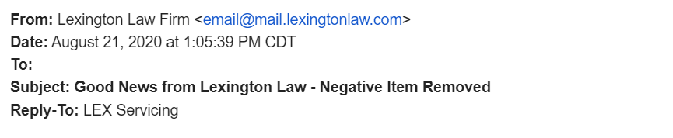

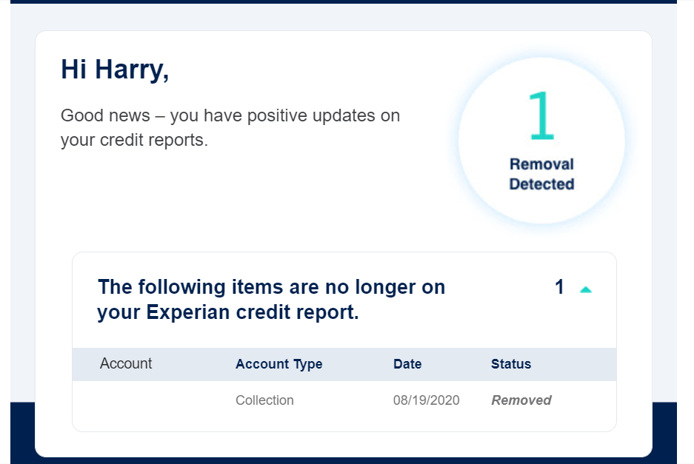
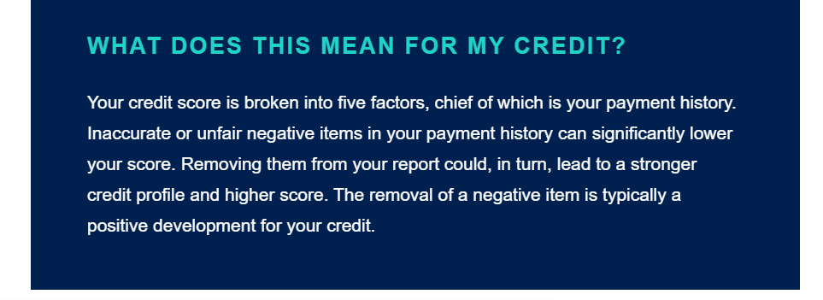
Credit Repair Reform:
HB3461 (Meyers-Martin) & SB2135 (Feigenholtz)
What’s the problem?
  If a “removed” item was ACCURATE, it can (and most likely will) be “reinserted”
    Creditors have that right
  CROs ALWAYS TELL consumers when items get “removed”
  They DON’T TELL consumers when items get “reinserted”
    Item shows up again; consumers don’t know why
XXXXX

Slide 34
Credit Repair Reform:
HB3461 (Meyers-Martin) & SB2135 (Feigenholtz)
In 1995, federal law passed to address the issue → Telemarketing Sales Rule (TSR)
Prohibits CROs from requesting / accepting fees without FIRST providing proof of lasting results
  Proof = two credit reports, pulled 6 months apart, showing an item came off and stayed off (powerful)
TSR never enforced → By 2022, credit repair a $4.4 billion industry (a few large companies; most small)
Two victims: □ People who buy credit repair services directly (millions)
        □ Small business owners (over 60,000) who invest in CROs without full information
24 years later, the Consumer Financial Protection Bureau (CFPB) took action
Sued Lexington Law in 2019 for violating the TSR → won in August 2023
    Settled for $2.7 billion in damages done to over 4 million people (since 2016)
Sued Credit Repair Cloud in 2021 for selling software to credit repair companies – at $179/month – that violate the TSR (case pending)
Regarding race, no data available from Lexington Law; from Credit Repair Cloud, we know 80% of their clients (small business owners) are people of color, and 68% make less than $24,000 per year

Slide 35
Credit Repair Reform:
HB3461 (Meyers-Martin) & SB2135 (Feigenholtz)
Why we need the proposed state bill:
TSR only applies to telemarketers; Lexington Law (now in Chapter 11 bankruptcy) reconstituting as an ONLINE company → no longer be subject to the TSR
We need help from the state; HB3461 (Meyers-Martin) & SB2135 (Feigenholtz):
    Adds TSR language (requiring proof before payment) to our existing credit repair statute
    Applies TSR language to ALL Illinois CROs, not just telemarketers
    Puts IDFPR in charge of monitoring / enforcing the amended statute (recourse for consumers)

Slide 36
Asks
Oppose Non-Agreed Bills in Veto
Co-Sponsor
  SB 2220 (Martwick – Protecting Family Futures)
  SB 2234 (Belt – Small Business Lending)
  SB 2135 (Feigenholtz – Credit Repair)
Please complete your evaluation ☺
Notes:
McNary

Slide 37
Q&A/
Discussion
Notes:
McNary

